Slide 1

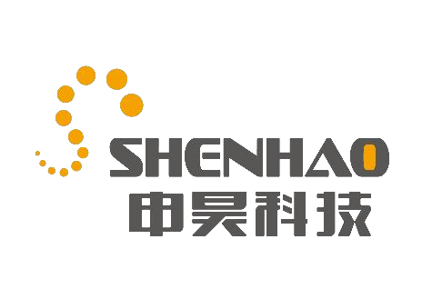
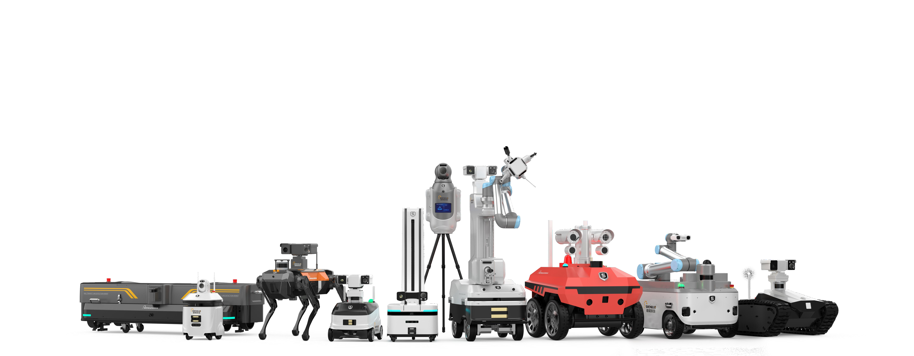
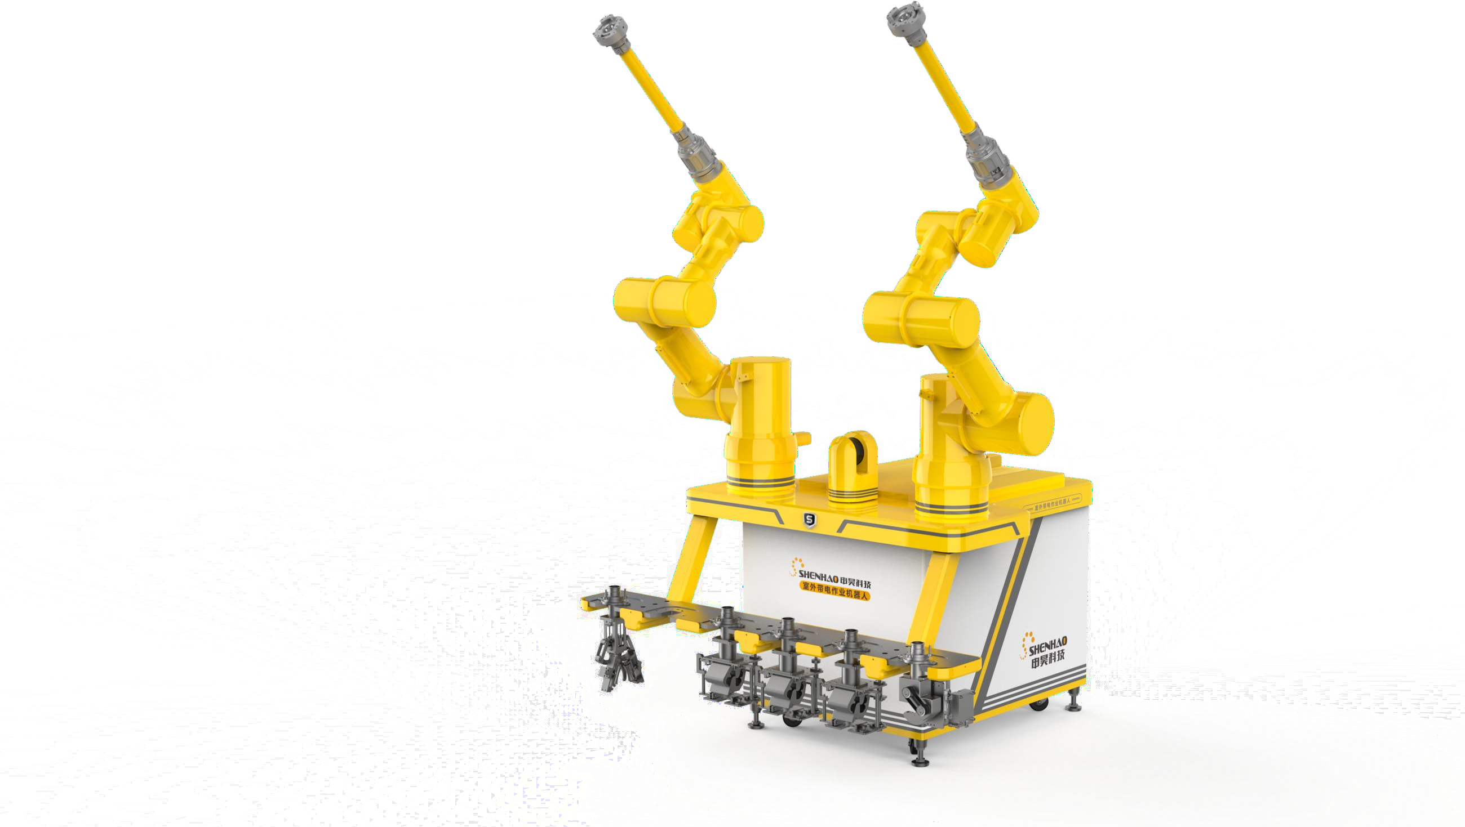
杭 州 申 昊 科 技 股 份 有 限 公 司
Stock Code：300853
H A N G Z H O U S H E N H A O T E C H N O L O G Y C O . , L T D
Introduction to Shenlong ROV

Slide 2
Application Scenarios of Shenlong ROV
01

Slide 3

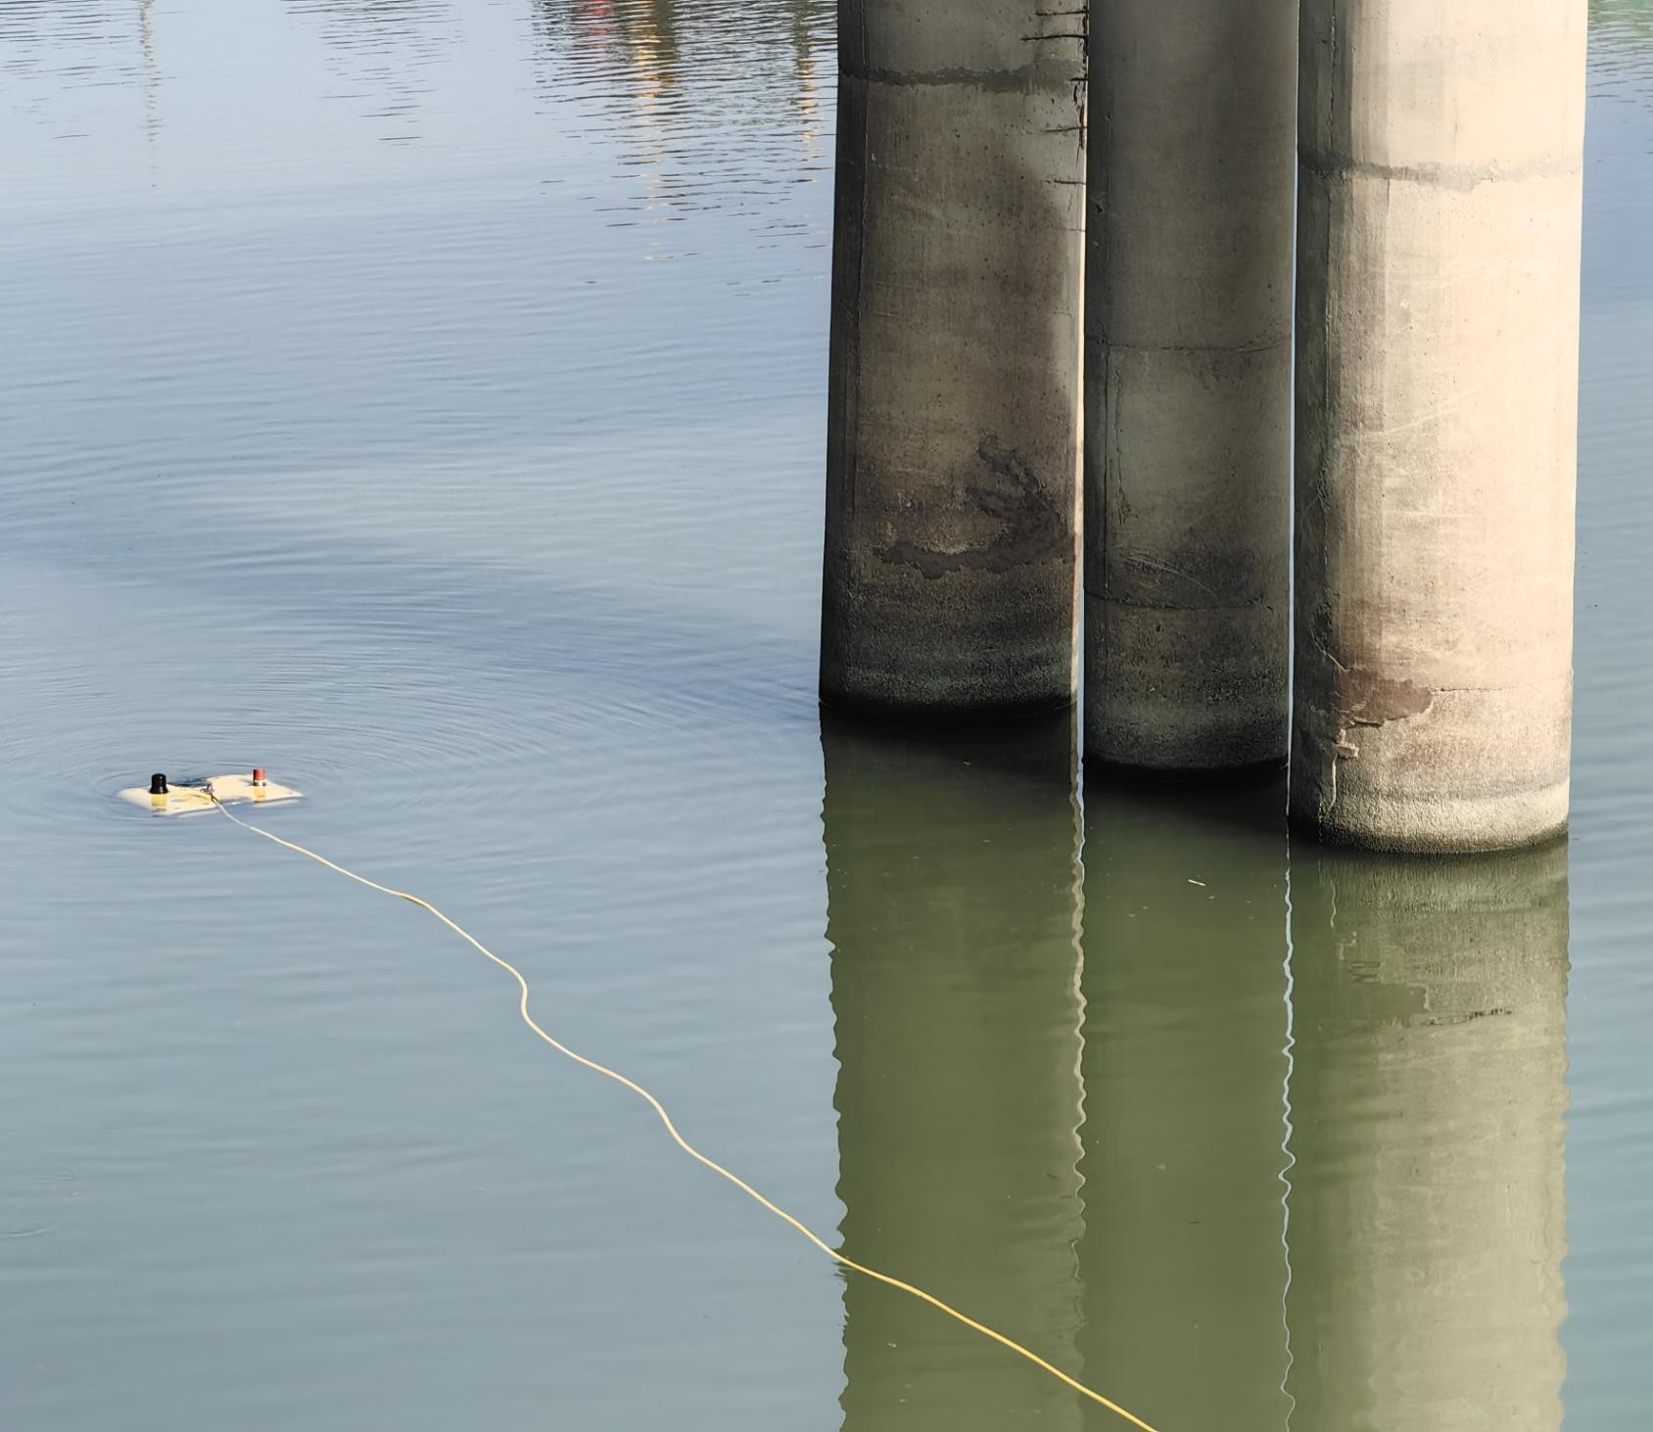
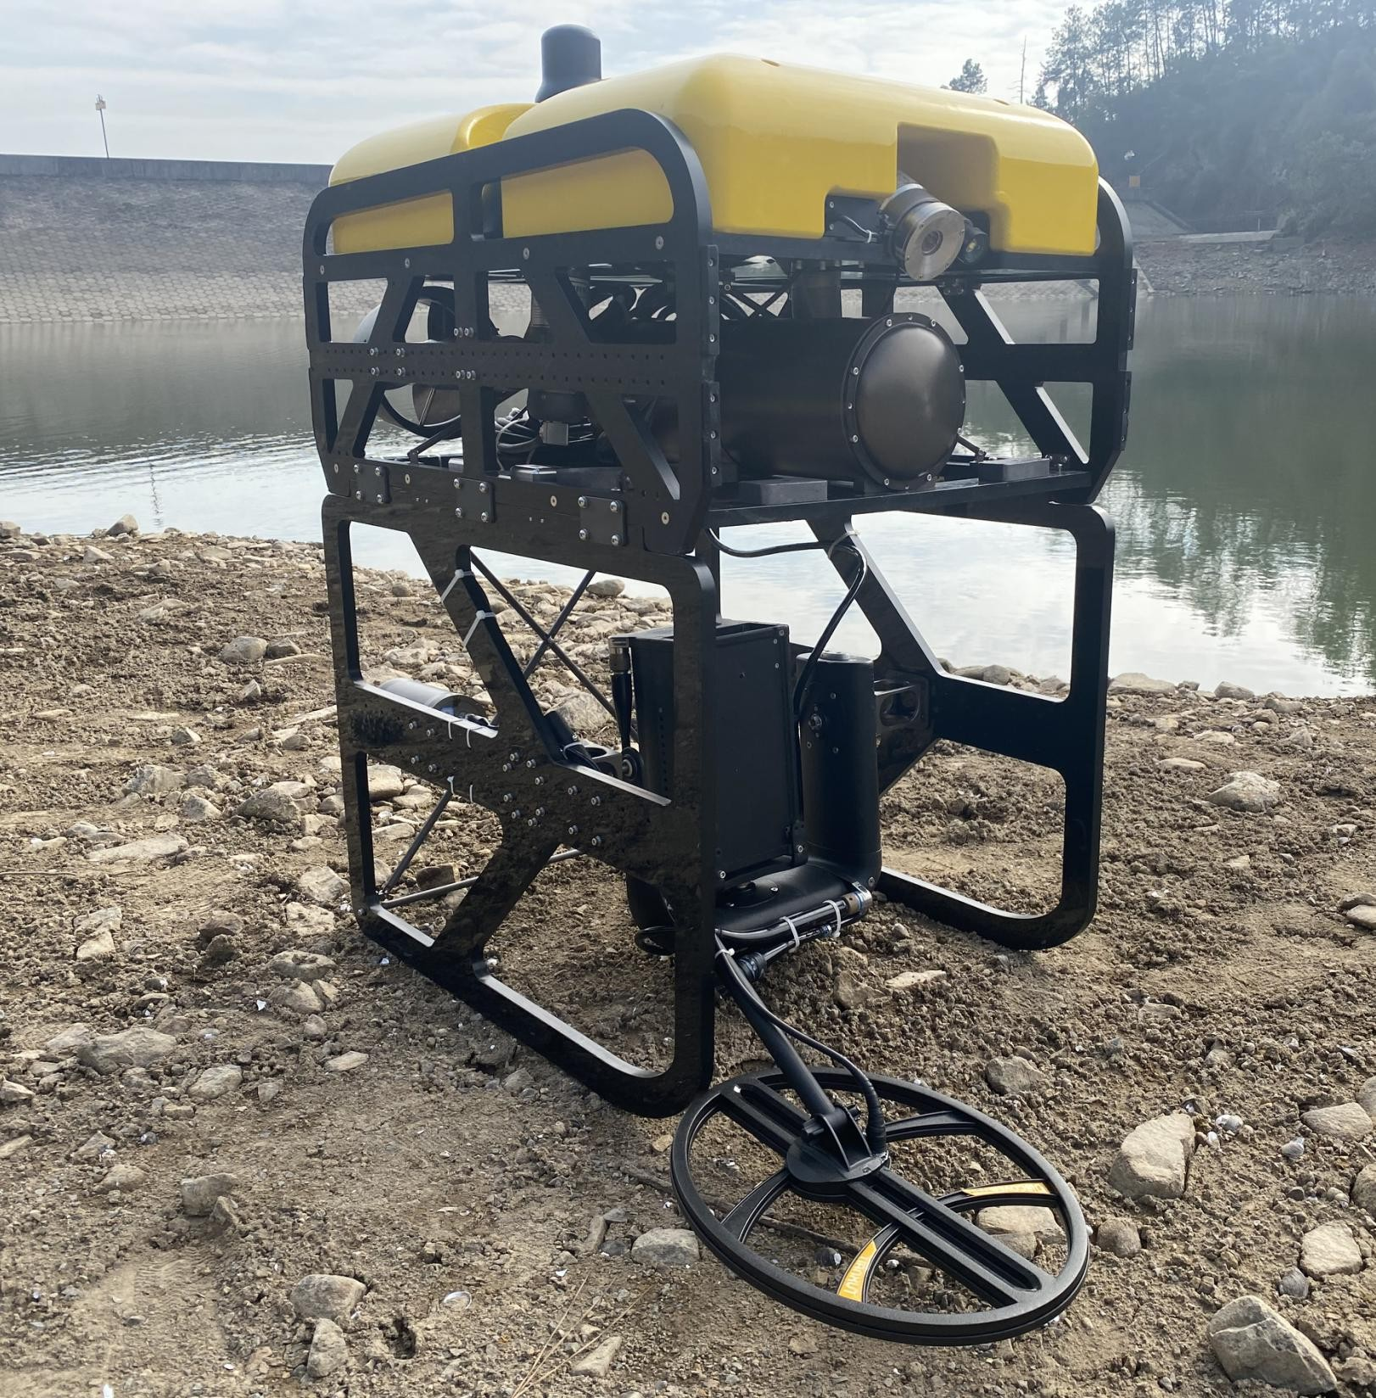
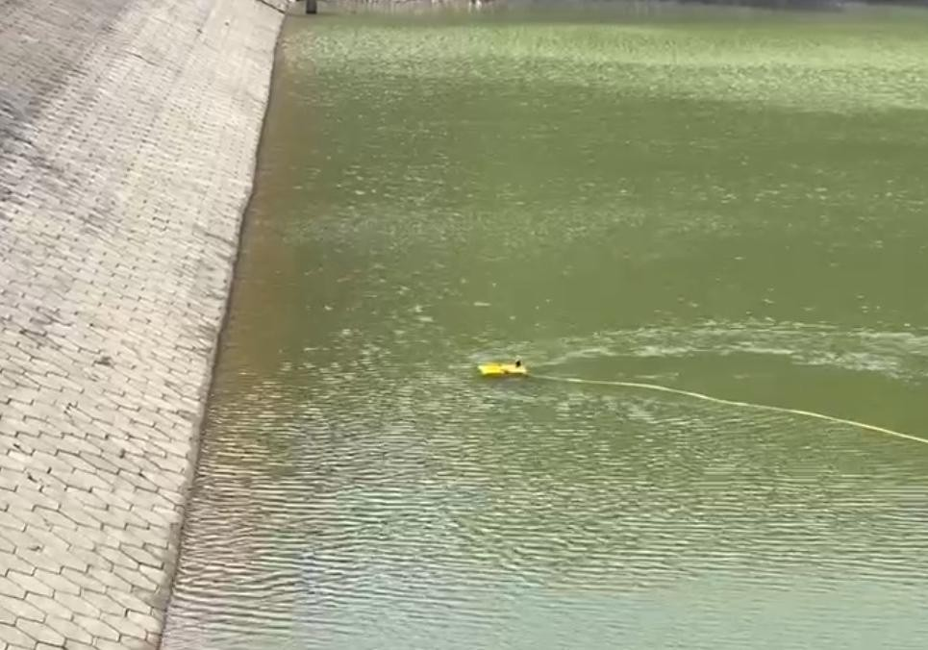

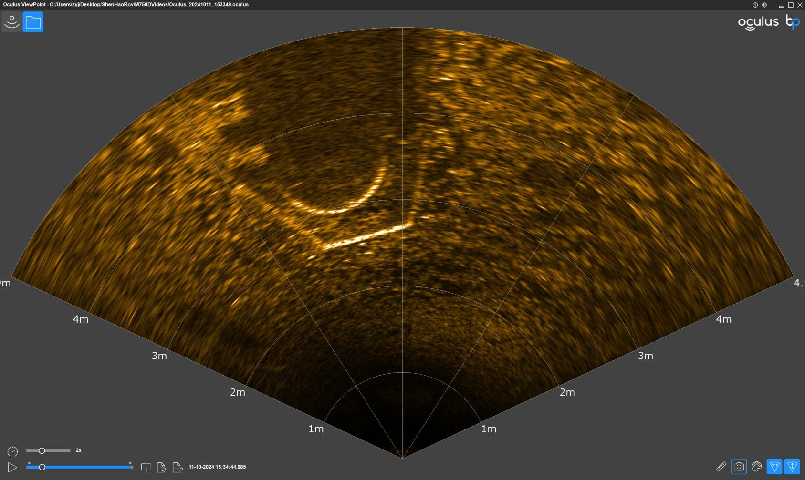
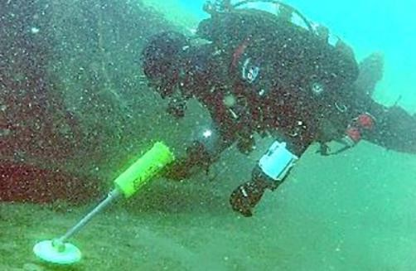
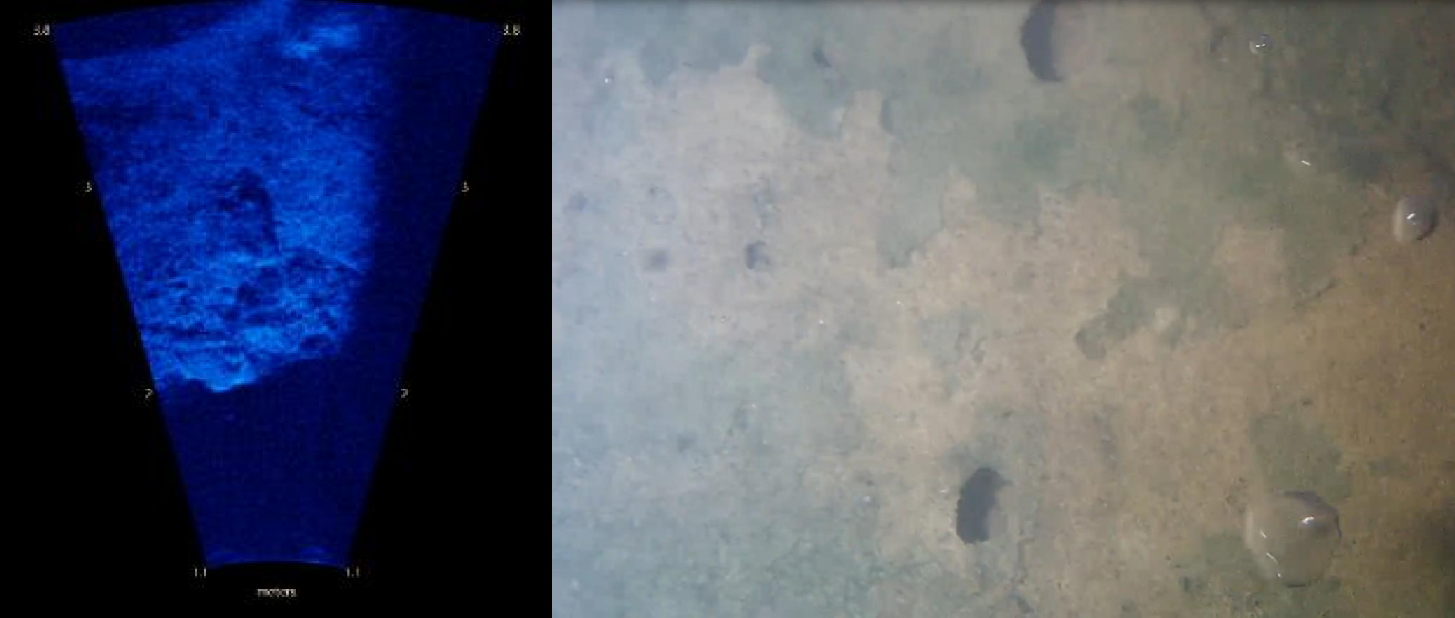
Application Scenarios of Shenlong ROV
PART
1.0
Application Scenarios
The ROV is equipped with an underwater metal detection system
Traditional divers carry out operations with underwater metal detection systems.
Bridge pier and pile foundation inspection and maintenance
Bridge piers of large bridges suffer from structural corrosion and surface erosion over years of water flow. ROVs can perform sonar imaging and video inspections to detect corrosion, scouring, and defects at the pier foundations, assessing operational safety. They can also conduct 3D imaging and modeling of the riverbed near the piers, build a maintenance and inspection database, and compare with historical data to ensure the safety of bridge pier infrastructure
Underwater Security and Explosive Ordnance Disposal
Reservoir Dam Inspection
Equipped with an underwater metal detection system, it can replace traditional divers for detecting underwater metal objects, detonators, etc., improving operational safety and efficiency. With the aid of imaging sonar and underwater cameras, it enables rapid identification of suspicious objects, making it suitable for use by public security and fire departments in special situations.
Using sonar, cameras, and other sensors to image and inspect structural damage, cracks, leakage, and underwater conditions of reservoir dams, replacing traditional diver inspections, improving operational safety, and reducing maintenance and inspection costs.

Slide 4
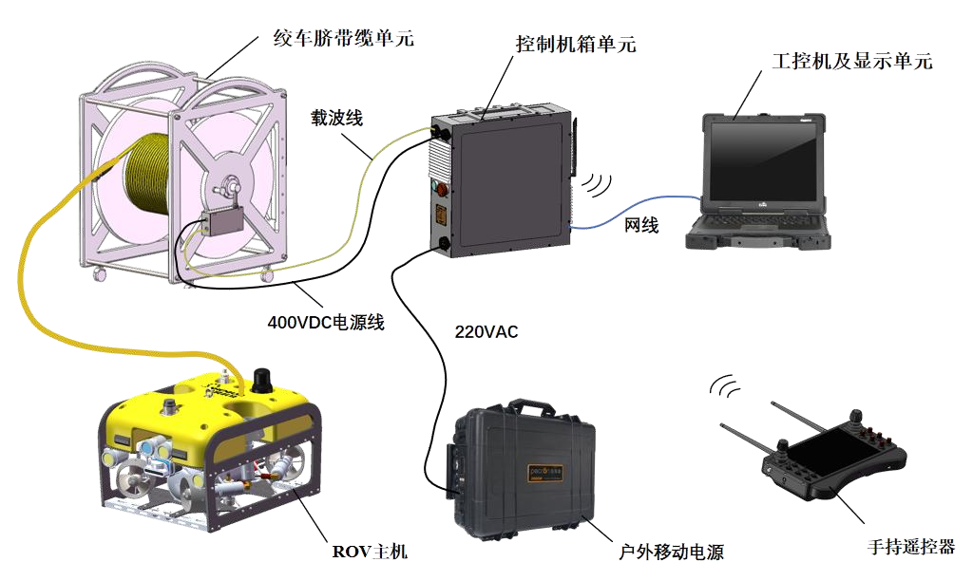




Shenlong ROV System Components
PART
1.1
Winch Umbilical extension Unit
Control Chassis Unit
Industrial Computer and Display Unit
Carrier line
Network
Cable
System Components
400VDC Power Cable
220VAC
Handheld Remote Control
2D Image Detection Sonar
Outdoor Power Bank
二维图像检测声纳
ROV Main Unit
The Shenlong ROV is a multifunctional light-duty ROV featuring a modular design and excellent underwater maneuverability. It supports manual remote control as well as automatic depth-keeping and heading-holding navigation. The basic onboard sensors include underwater lights, underwater camera, depth sensor, and temperature sensor. Acoustic sensors include a two-dimensional imaging sonar and a DVL (Doppler Velocity Log) sensor. It is compatible with extensions such as obstacle avoidance sonar, underwater positioning systems, and altimeters. Main functions include underwater altitude measurement, depth measurement, high-brightness underwater lighting, real-time underwater camera imaging, real-time underwater sonar imaging, and underwater gimbal angle adjustment. During operations, it can perform underwater video recording, photographing, and, even in turbid water environments, achieve high-resolution sonar imaging with a maximum resolution of up to 2.5mm.

Slide 5
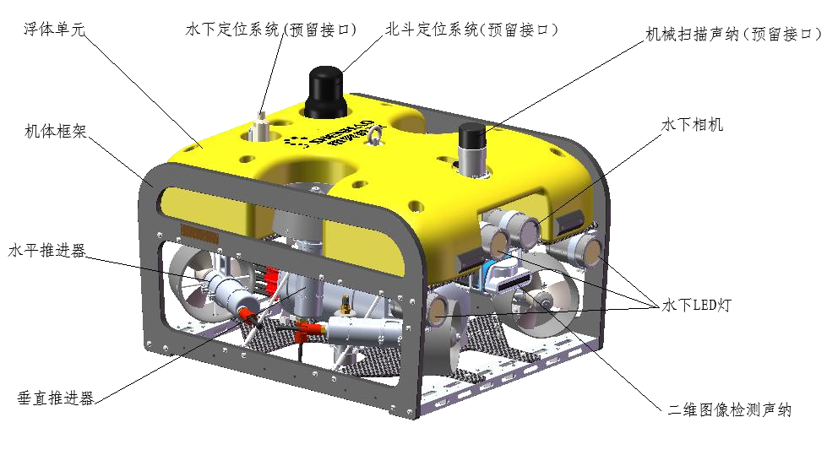
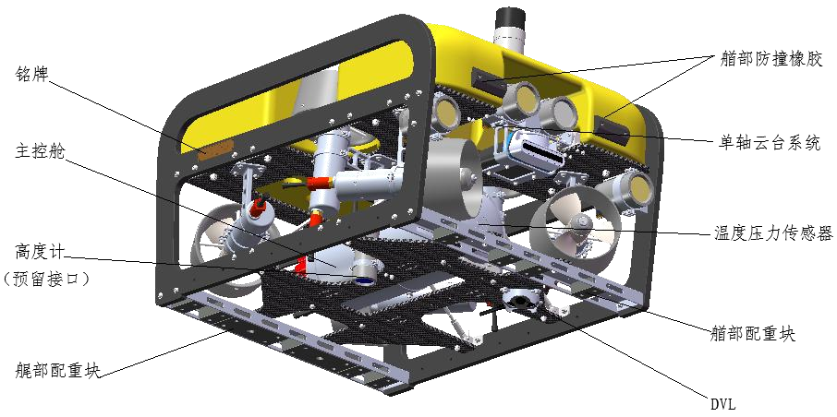
Shenlong ROV Main Unit
PART
1.2
Underwater Positioning System (Reserved Interface)
Beidou Positioning System
(Reserved Interface)
Floating Body Unit
Mechanical Scanning Sonar
(Reserved Interface)
Features：
High Power Output: Maximum 4.8kW
High Load Capacity: Up to 10kgf
Modular Design: Flexible combination, easy maintenance
High Expandability: Reserved universal power and communication interfaces
Precision Control: Equipped with advanced motion control algorithms, enabling autonomous depth holding, heading locking, and position locking (automatic current resistance)
Body Frame
Underwater Camera
Horizontal Thruster
Underwater LED Lights
Vertical Thruster
2D Image Detection Sonar
Anti Collision Rubber
Name Plate
Main Control Cabin
Single Axis Gimbal System
Altimeter (Reserved
Interface)
Temperature Pressure Sensor
Stern Counterweight Block
Stern Counterweight
DVL

Slide 6
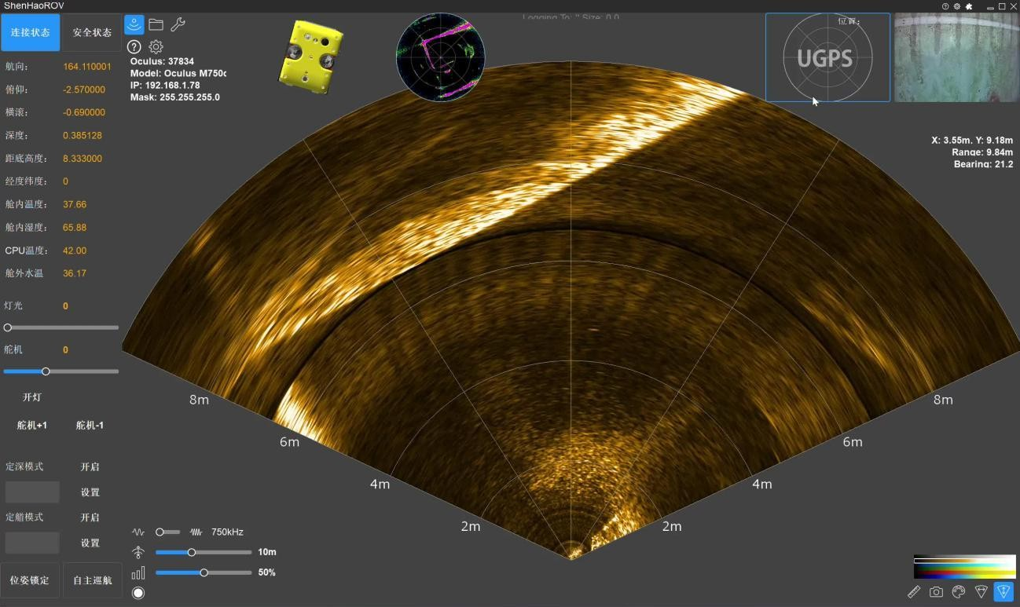
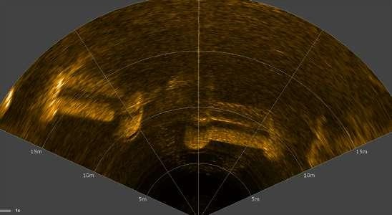
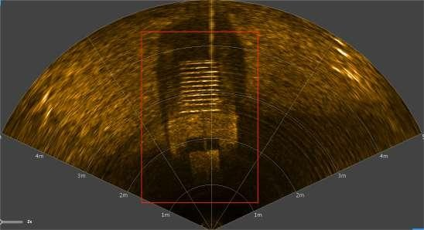
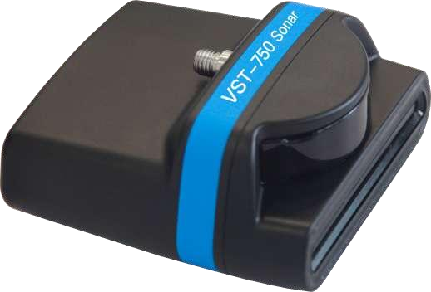
2D Imaging Detection Sonar
PART
1.3
Pier Scanning Imaging Effect
Underwater Gate Imaging Effect
Sonar Detection Display and Control Interface
2D Imaging Detection Sonar

Slide 7
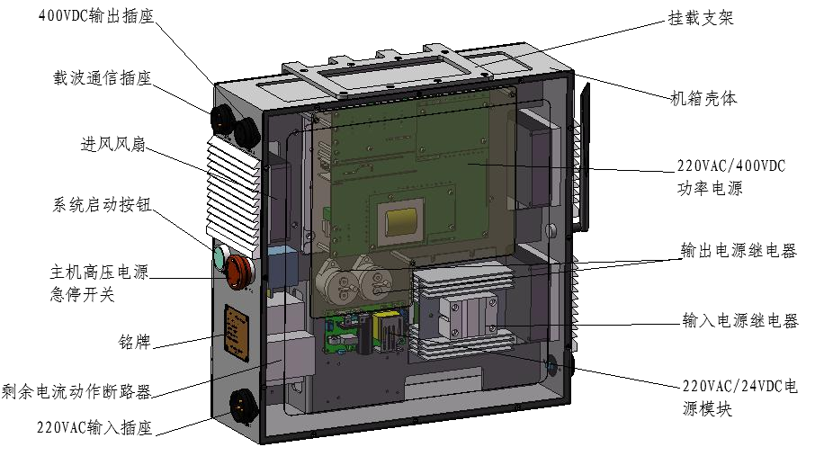
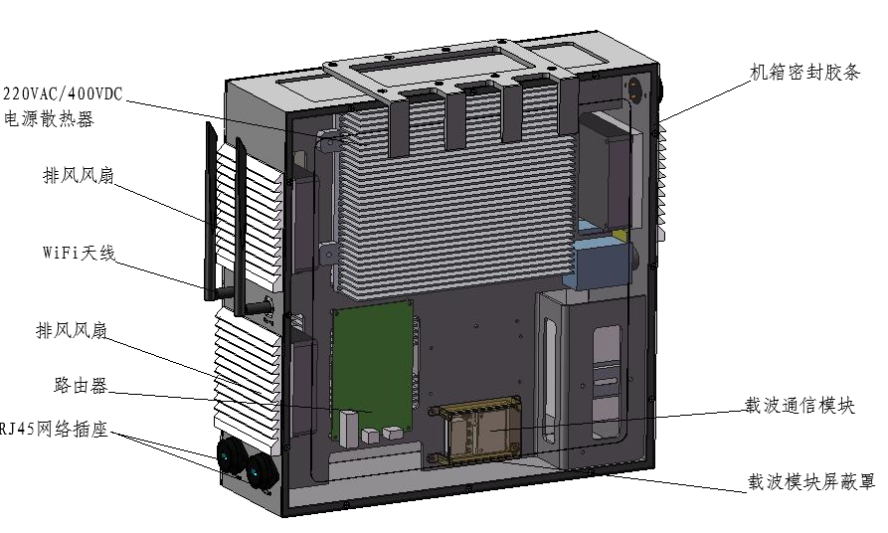
Control Cabinet Unit
PART
1.4
400VDC Output Socket
Mounting Bracket
Carrier Communication Socket
220VAC/400VDC Power Supply
Heat Dissipation
Chassis Sealing Strip
Chassis Shell
Inlet Fan
Exhaust Fan
220VAC/400VDC
Power Supply
System Start Button
Wi-Fi Antenna
Host High Voltage Power Supply
Output Power Relay
Exhaust Air Plant
Emergency Stop Switch
Input Power Relay
Router
Carrier Communication Module
Nameplate
RJ45 Network Socket
Residual Current Operated Circuit Breaker
220VAC/24VDC Power Module
Carrier Module Shielding Cover
220VAC Input Socket
Specifications | Parameters | Specifications | Parameters
Machine weight | 15kg | Output voltage ripple and noise | ≤10Vp-p
Input voltage | 85VAC~265VAC | Communication method | Carrier to Ethernet (wired or wireless)
Maximum output power | 6.6kW | Wi-Fi Frequency band | 5GHz/2.4GHz
Rated output voltage | 400VDC | Maximum communication bandwidth | 500Mbps
Output current range | 0～20A | IP rating | IP53
Safety protection functions | Input over-voltage protection, under-voltage protection, over-current protection; Output over-voltage protection, under-voltage protection, over-current protection, short-circuit protection, reverse polarity protection, over-temperature protection (power reduced by half at 70°C, output closed at 85°C), leakage protection | Operating temperature | -40～75℃
Emergency stop function | Equipped with high-voltage power emergency stop function for wet-ends | Operating humidity | 5%～95%

Slide 8
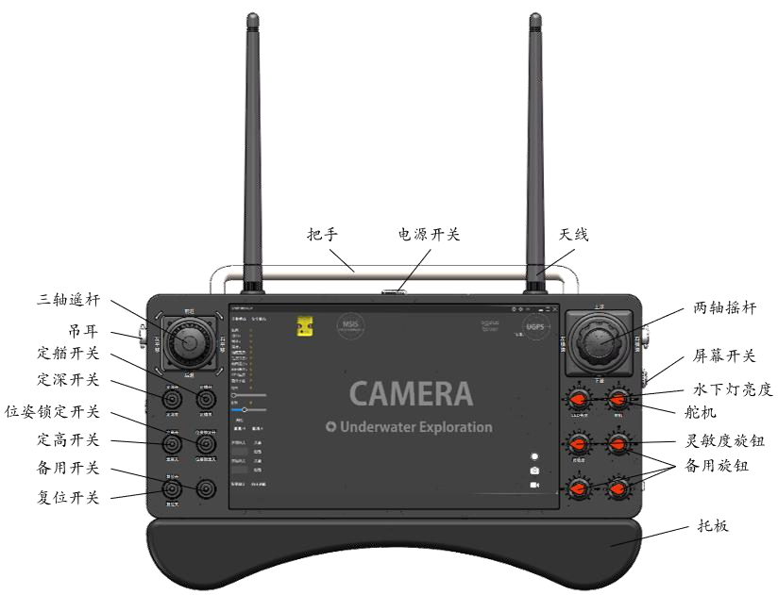


Handheld controller
PART
1.5
Main Functions：
Left joystick: Controls ROV translation; rotate left/right to steer, push up/down to move forward/backward, push left/right to strafe.
Right joystick: Push up/down to ascend/descend.
Left toggle area: Switches system states on/off according to panel labels. Reset button reconnects in case of idle time, communication error, or Wi-Fi disconnection.
Right knob area: Adjusts system parameters; fully counterclockwise is 0, fully clockwise is maximum.
Startup process: Press power button; after a beep, the controller powers on and enters the software automatically (around 30 seconds total).
Handle
Power Switch
Antenna
Three-Axis Remote Control
Two-Axis Rocker
Lifting Ears
Navigation Switch
Screen Switch
Depth Switch
Underwater Light Brightness
Position
Lock Switch
Steering Gear
Height Switch
Sensitivity Knob
Backup Switch
Spare Knob
Reset Switch
Pallet

Slide 9
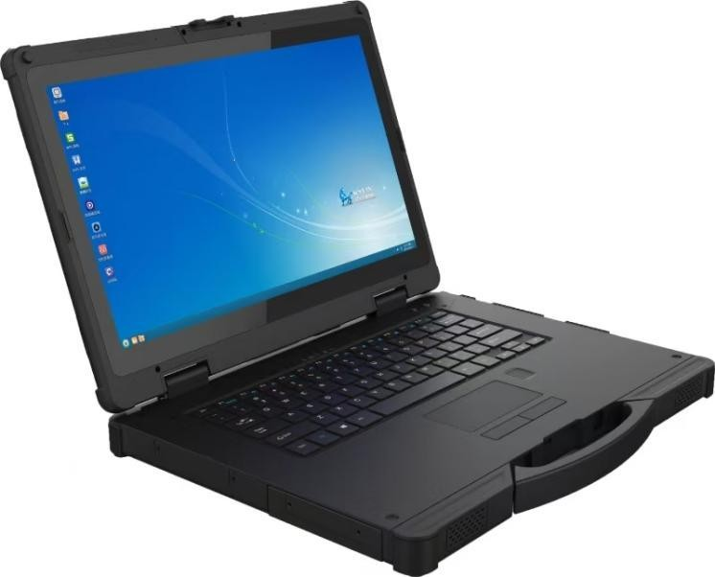
Industrial Computer and Display Unit
PART
1.6
Specifications | Parameters
Processor | Intel Core i7-1165 G7 Processor
Graphics Card | Integrated Graphics Card
Display Screen | 15.6-inch sunlight-readable LCD display, resolution 1920×1080
Memory | 16G
Storage | 512GB
Ports | 2 RJ45 network ports, 1 COM port (RS232 DB9), 3 USB 3.0, 1 USB 2.0. 4o mini
Battery life | Built-in battery provides approximately 0.5 hours of battery life (with default 50% volume, 200 lumens brightness, and playing 720P HD video). External battery provides approximately 6 hours of battery life (with default 50% volume, 200 lumens brightness, and playing 1080P HD video)
I/O Ports | HDMI x1, POGO 5pin x1, USB 2.0 Type-A x1, USB 3.0 Type-A x3, SIM Card x1, SD Card x1, DB9 RS232 x1, RJ45 Ethernet Ports x2, φ3.5mm Standard Headphone Jack x1, DC 19V 3.42A Power Input x1, Custom Adapter Card PCIe X4 Slot or HDD x1 (Optional)
Data Communication / Optional Modules | Wi-Fi module, Bluetooth 5.1, optional 2G/3G/4G/5G modules, built-in GPS with optional GPS + Beidou, built-in SPI fingerprint (for boot login), optional NFC
Temperature | Operating temperature: -20℃ to +60℃, storage temperature: -30℃ to +70℃.
Appearance dimensions | 407×305.8×45.5mm (main unit)
Weight | Bare machine: 3300g
Supported systems | Windows 10 64-bit Enterprise Edition
Product Certification | IP65 certification, MIL-STD-810H certification
Main Functions：
he ground station runs control and display software to store and manage video, sonar, and other data collected by the ROV underwater.
It uses a 15.6" rugged laptop, portable for outdoor use, with IP65 protection capability.

Slide 10
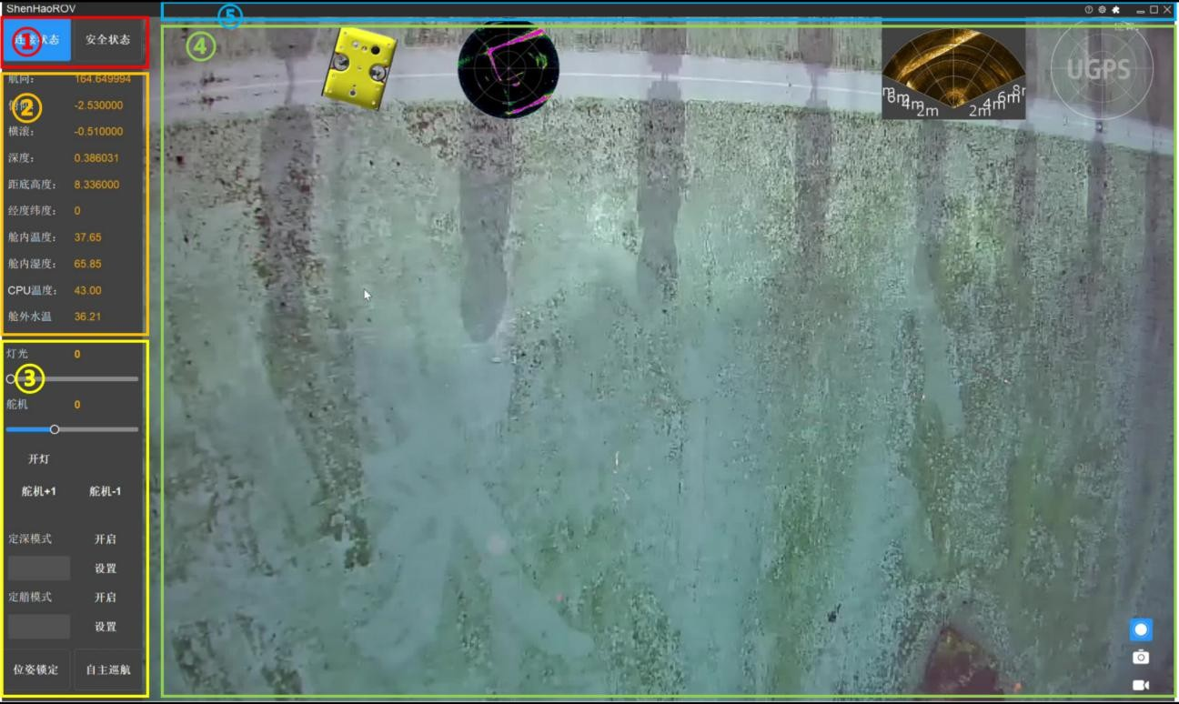
ROV display and control software
PART
1.7
Top menu bar
Main display area
Connection status panel
Information monitoring panel
Device control panel

Slide 11
Application cases
02

Slide 12
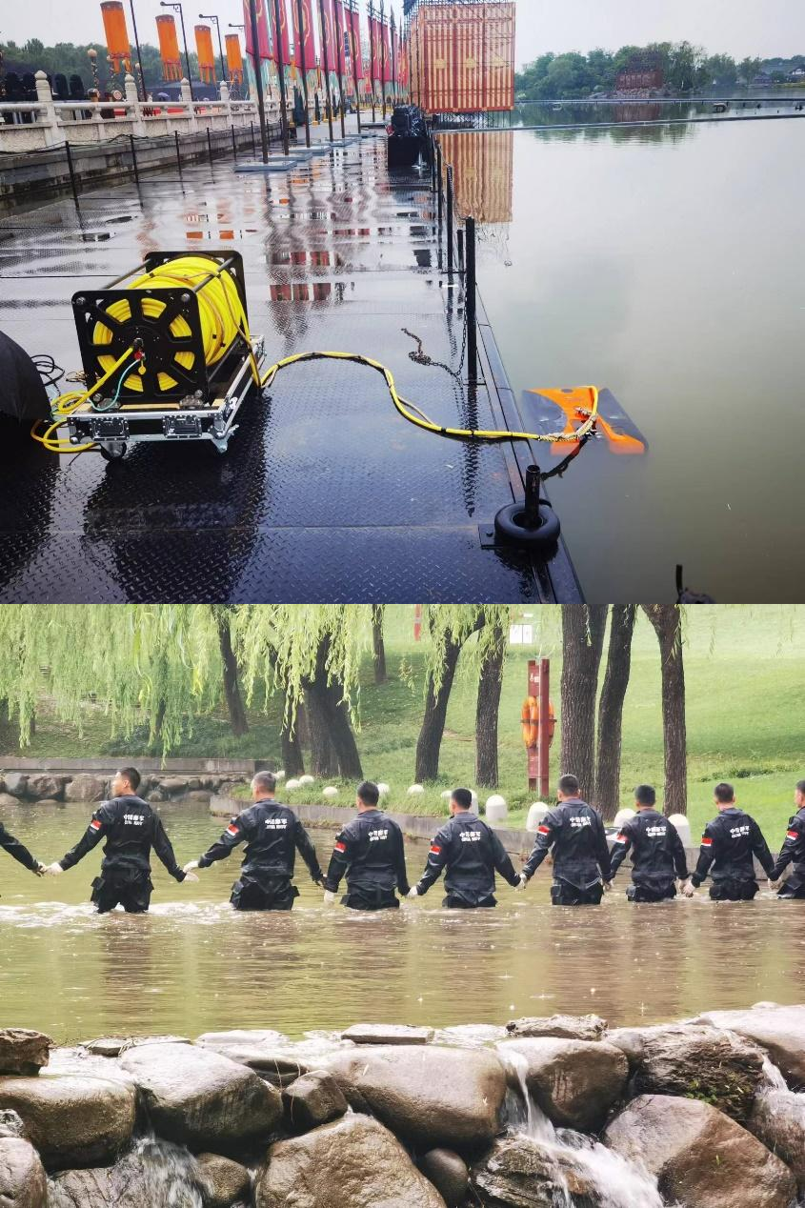
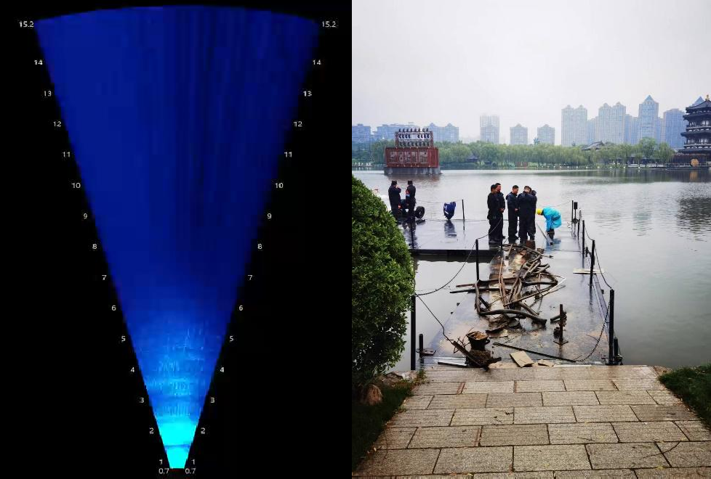
Case Study- Underwater Security for the "China-Central Asia Five Countries" Summit
PART
2.1
In May 2023, participated in the underwater security project for the "China-Central Asia Five Countries" Summit. In the waters of the venue where leaders were watching the event, the Shenglong Detection No.1 system was used alongside the Chinese Navy's Shallow Water Force for underwater object detection and retrieval.

Slide 13
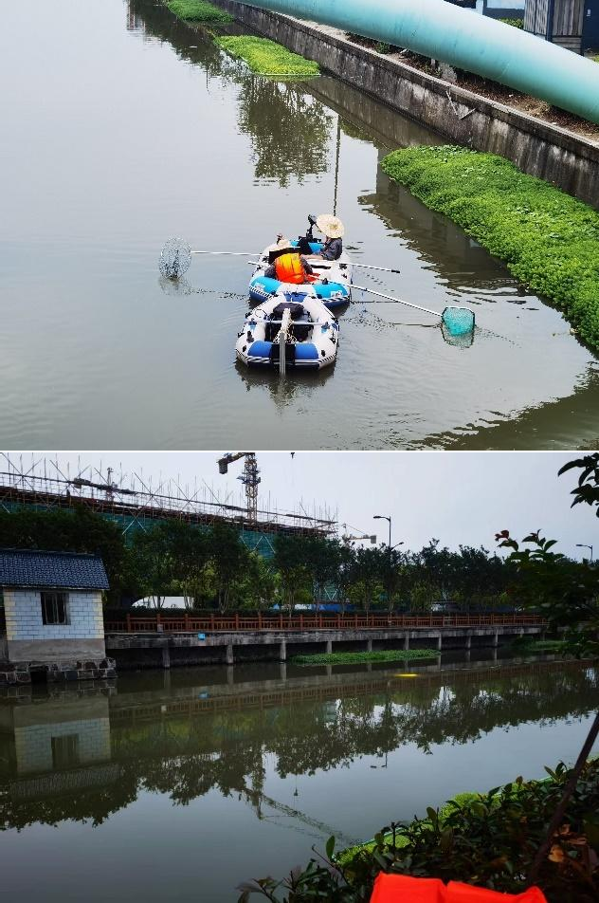
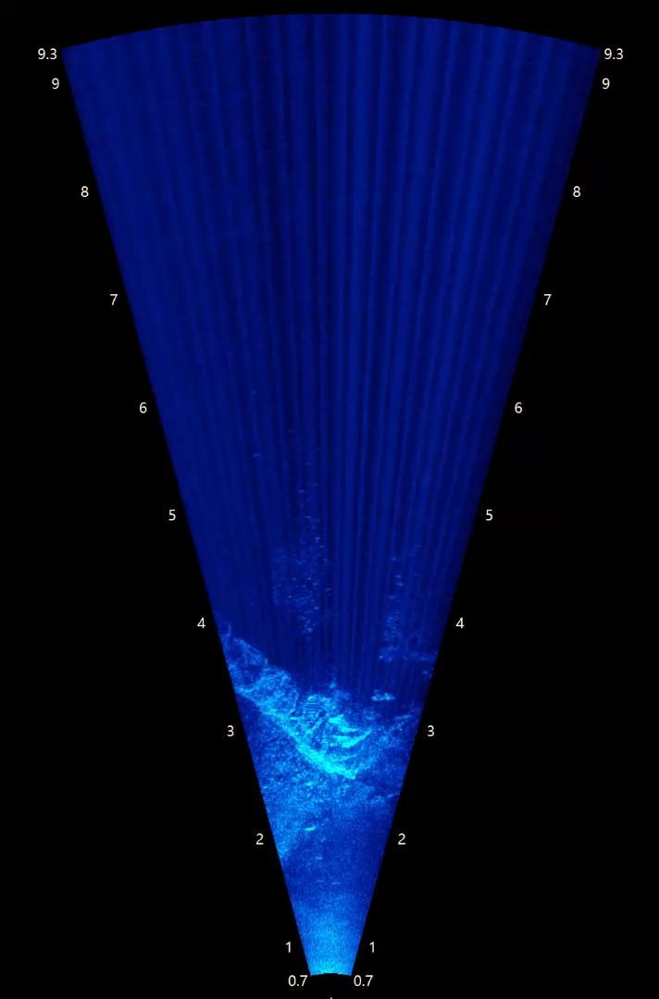
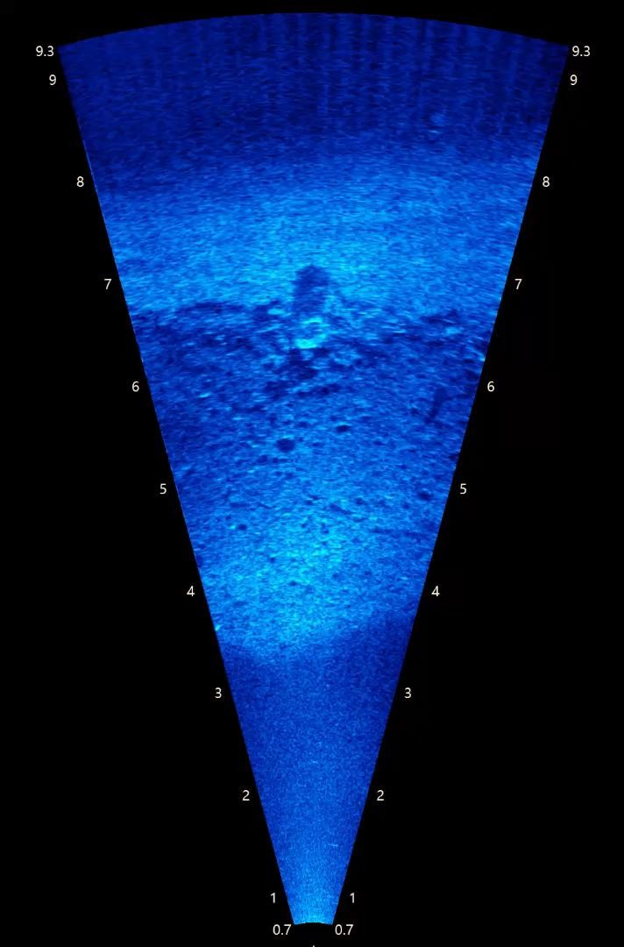
Case Study - Underwater Evidence Search in a River
PART
2.2
In April 2023, for a public security water-related case in a certain location, underwater evidence was searched. Using sonar high-definition imaging to identify underwater target objects, the items were then recovered. The entire process was visible and recorded.

Slide 14
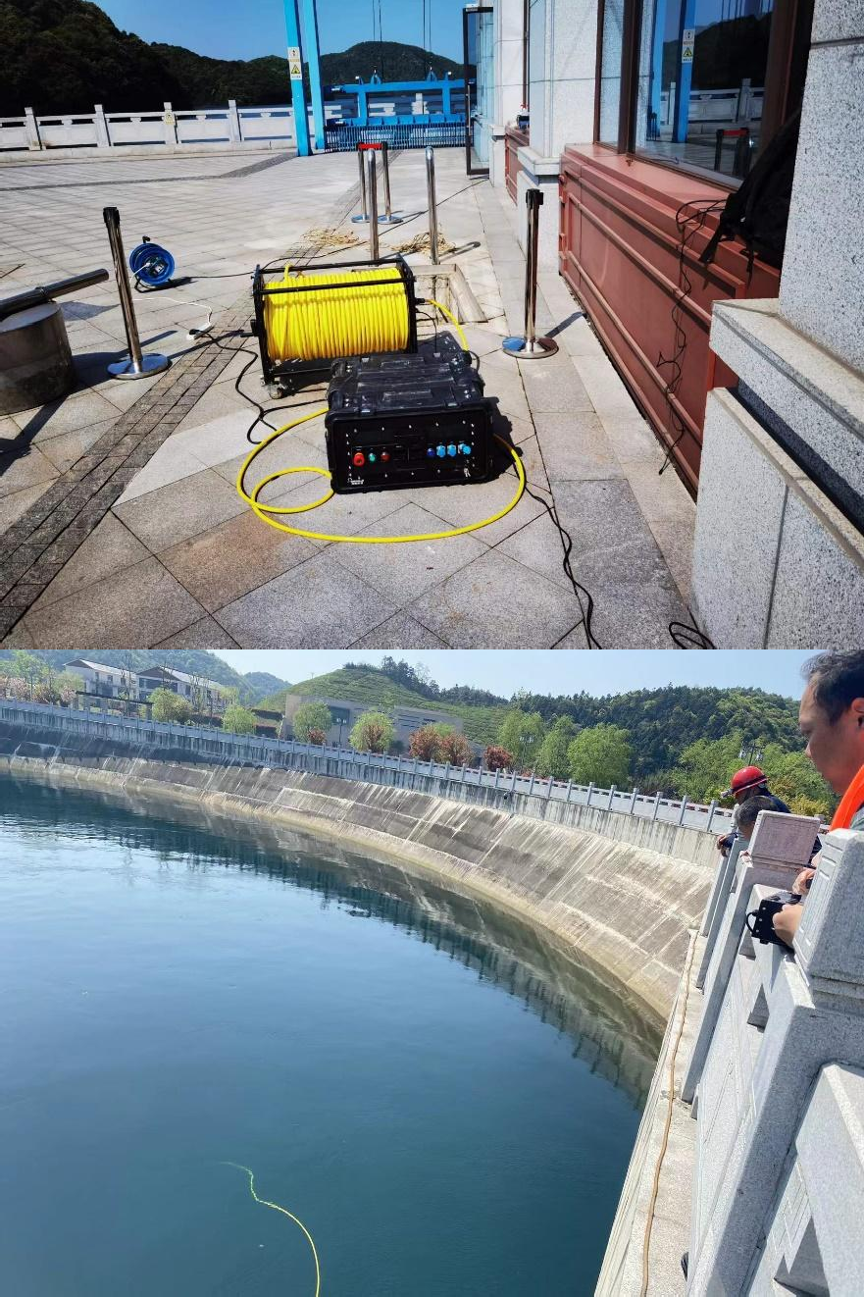
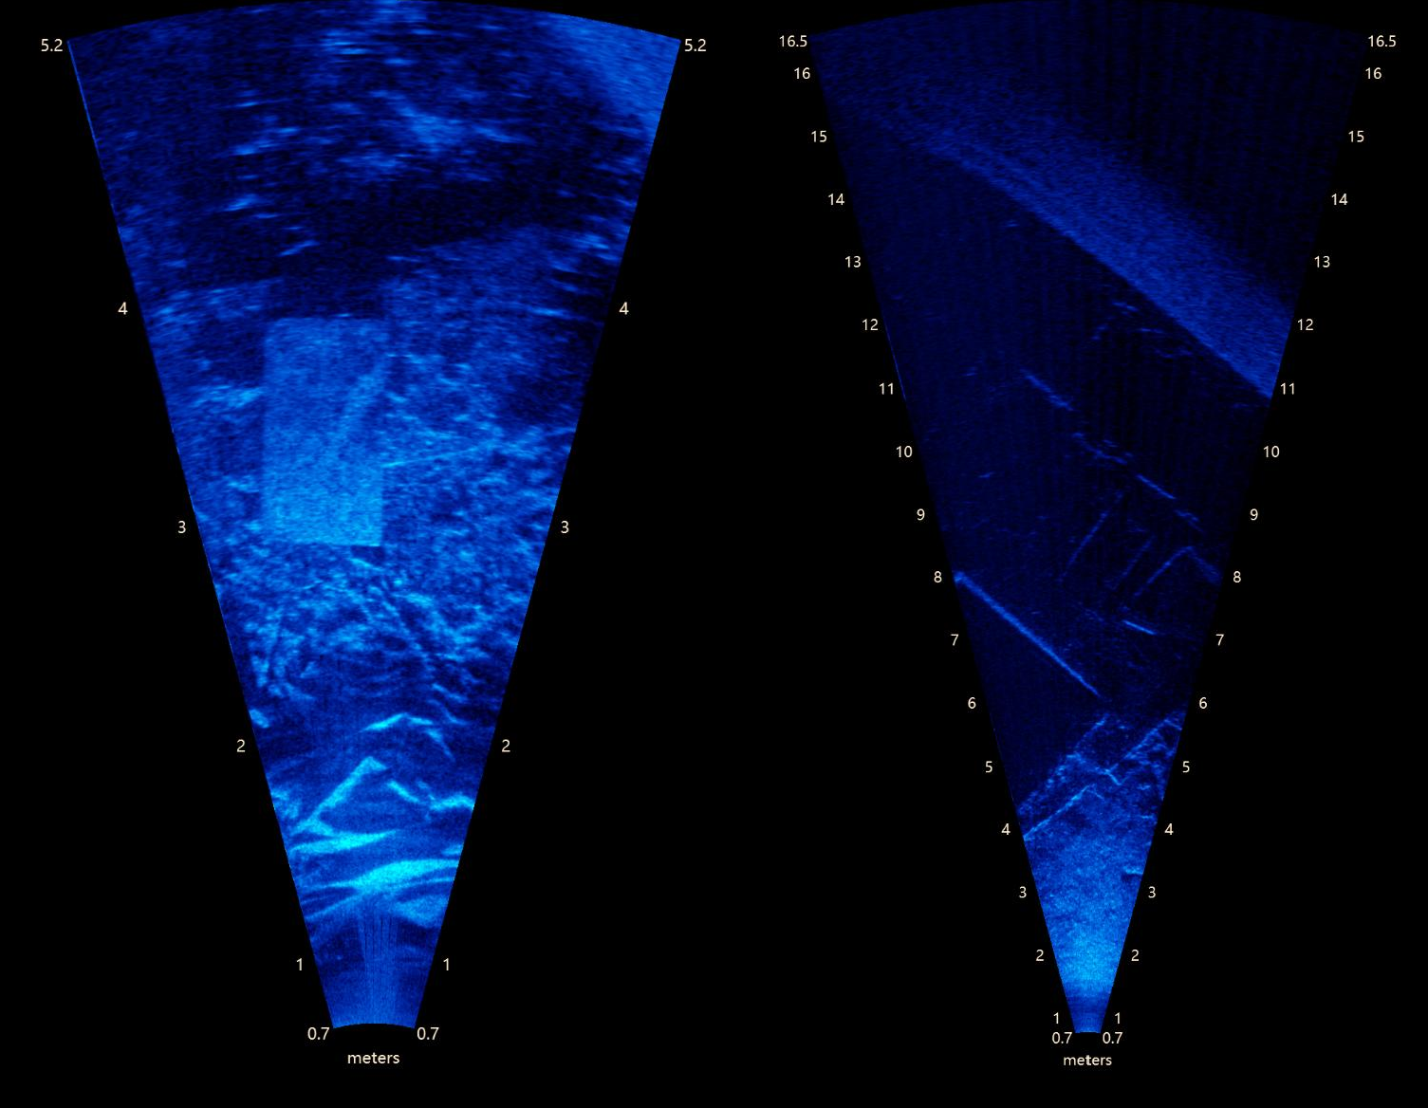
Case Study - Detection and Search for Submerged Debris in a Reservoir
PART
2.3
In April 2023, for the detection and search of submerged debris in a reservoir, our company used a high-definition sonar system to assist in the implementation, providing clear detection of underwater foreign objects and pits, with full visualized detection services throughout the process.

Slide 15
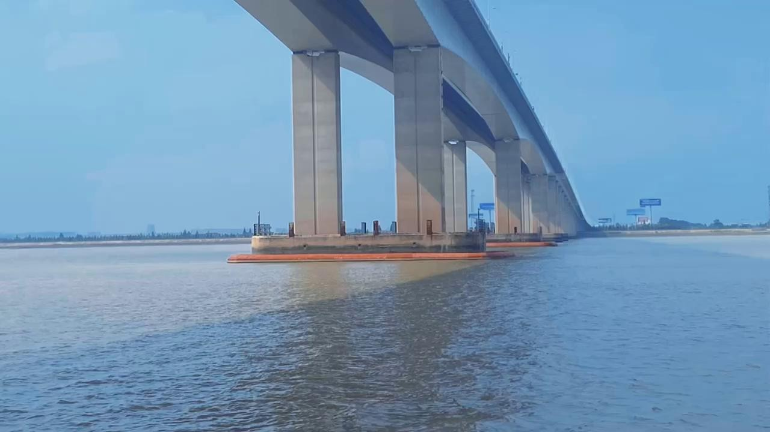
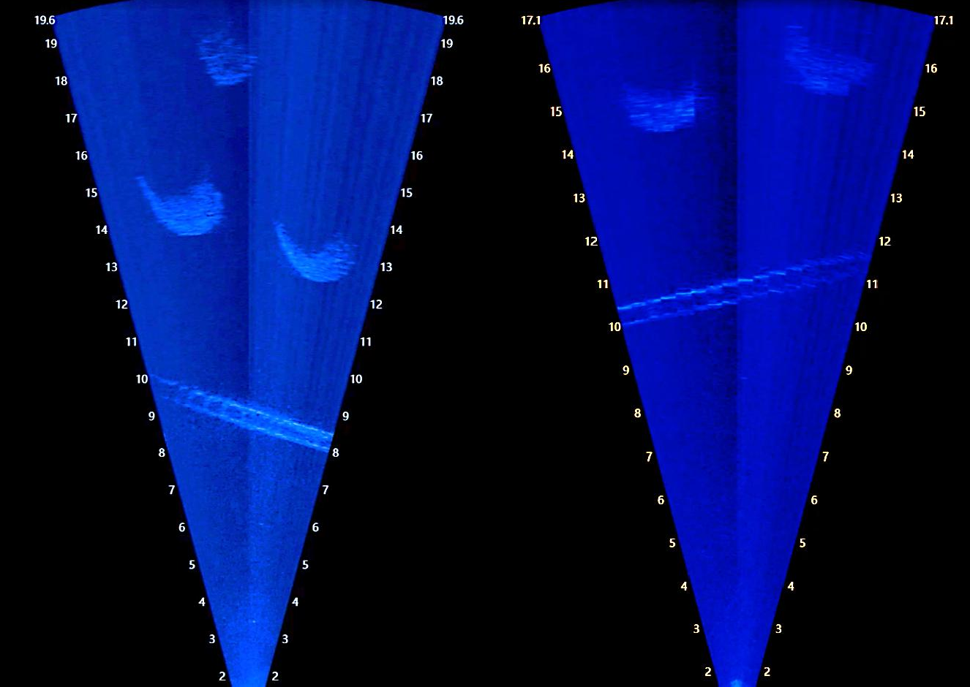
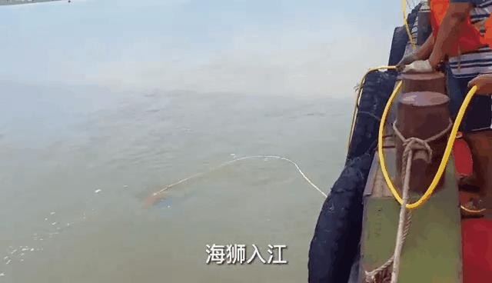
Case Study - Search for the Fallen Collision Protection Ring of the Chongqi Bridge in Shanghai
PART
2.4
Search for the Fallen Collision Protection Ring of the Chongqi Bridge in Shanghai: After several unsuccessful attempts by divers, on July 24, 2022, the position of the collision protection ring was easily located using the Shenlong Detection No. 1 Turbid Water Detection System.
ROV enters the sea

Slide 16
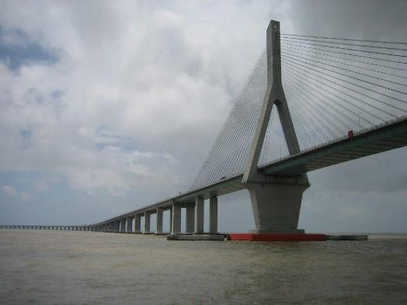
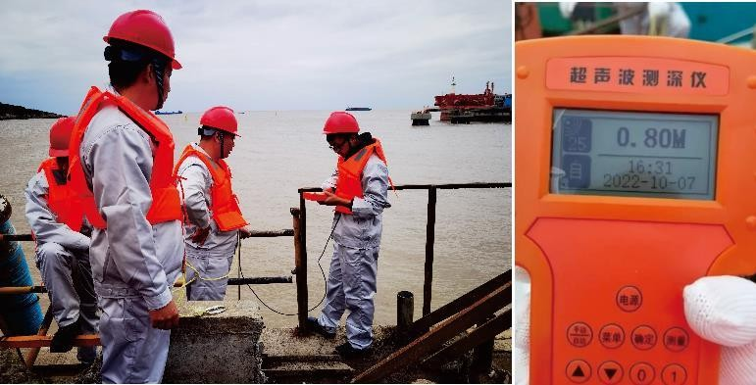
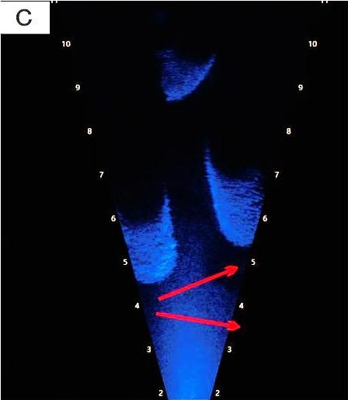
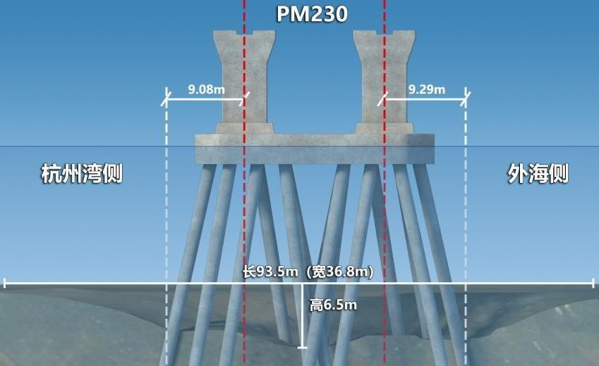
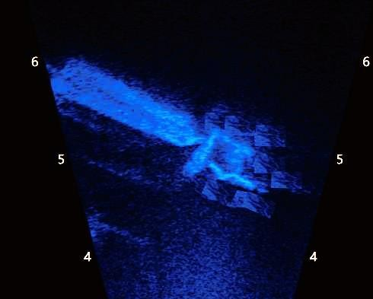
Case Study - Real-time Monitoring of Scour Area Reinforcement at Bridge Pier Foundations of the Donghai Bridge
PART
2.5
Hangzhou
Bay Survey
Offshore Side
Length: 93.5 meters (Width: 36.8 meters)
Height: 6.5 meters
On October 8, 2022, for the pilot project of scour area reinforcement at the bridge pier foundations of the Donghai Bridge, our company used a high-definition sonar system to assist in the implementation, clearly presenting images of the bridge piers and grouting pump heads, providing full visualized detection services for the grouting work.

Slide 17

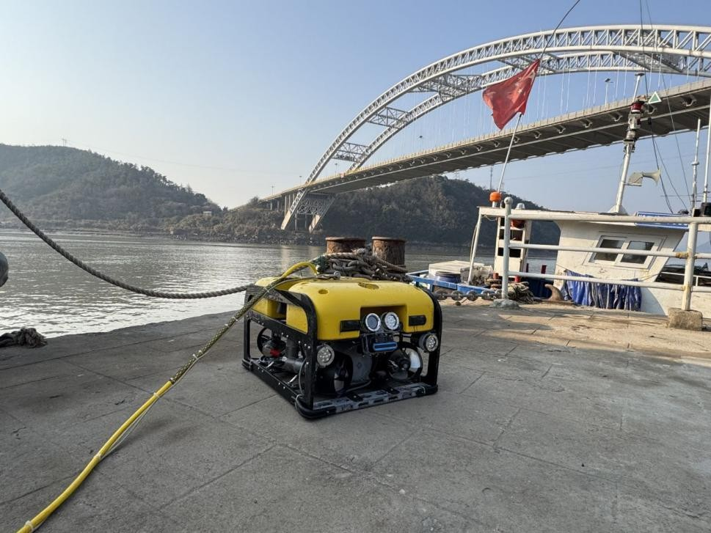
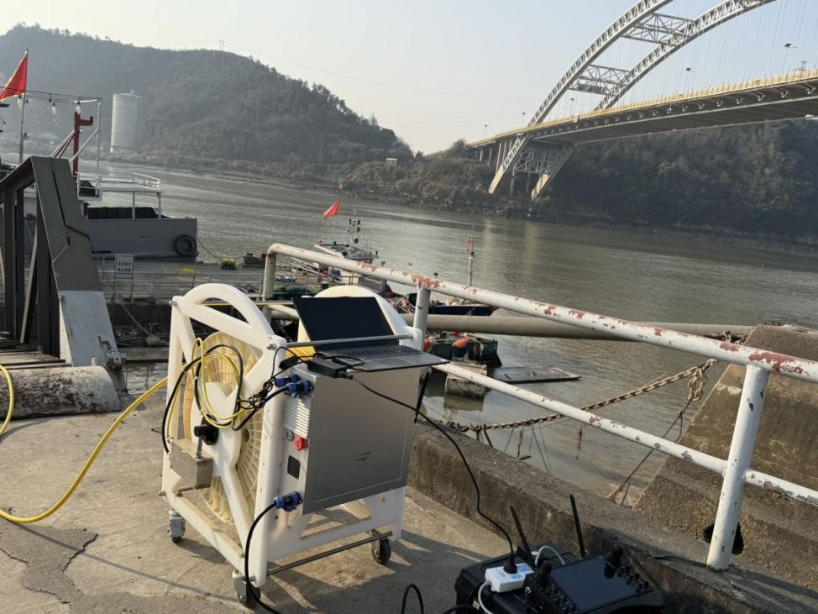
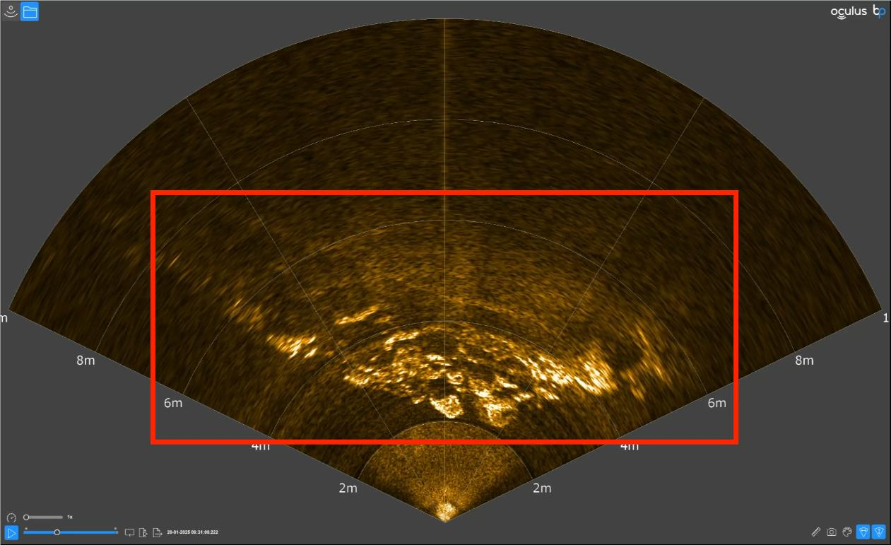
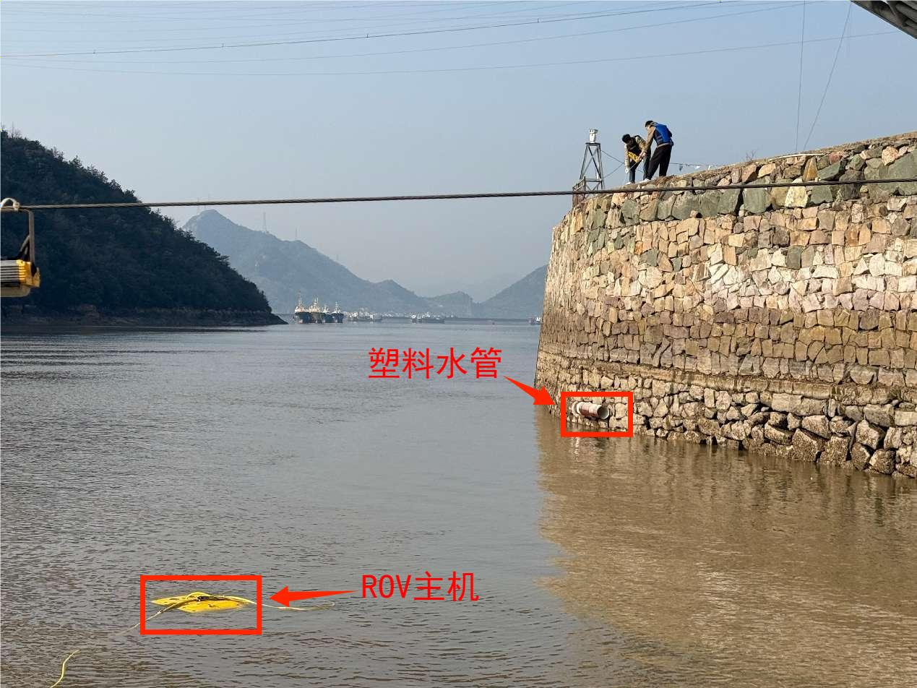
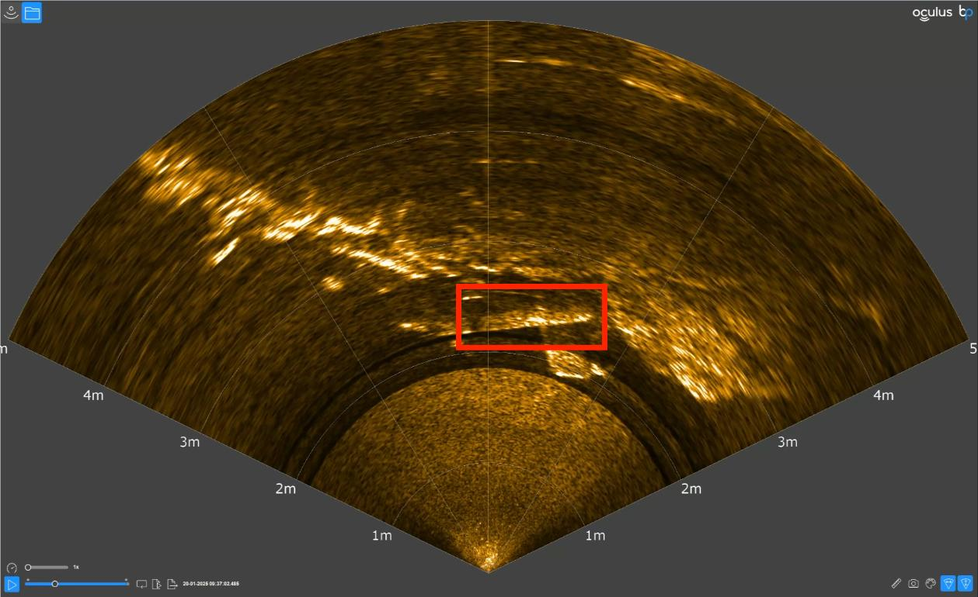
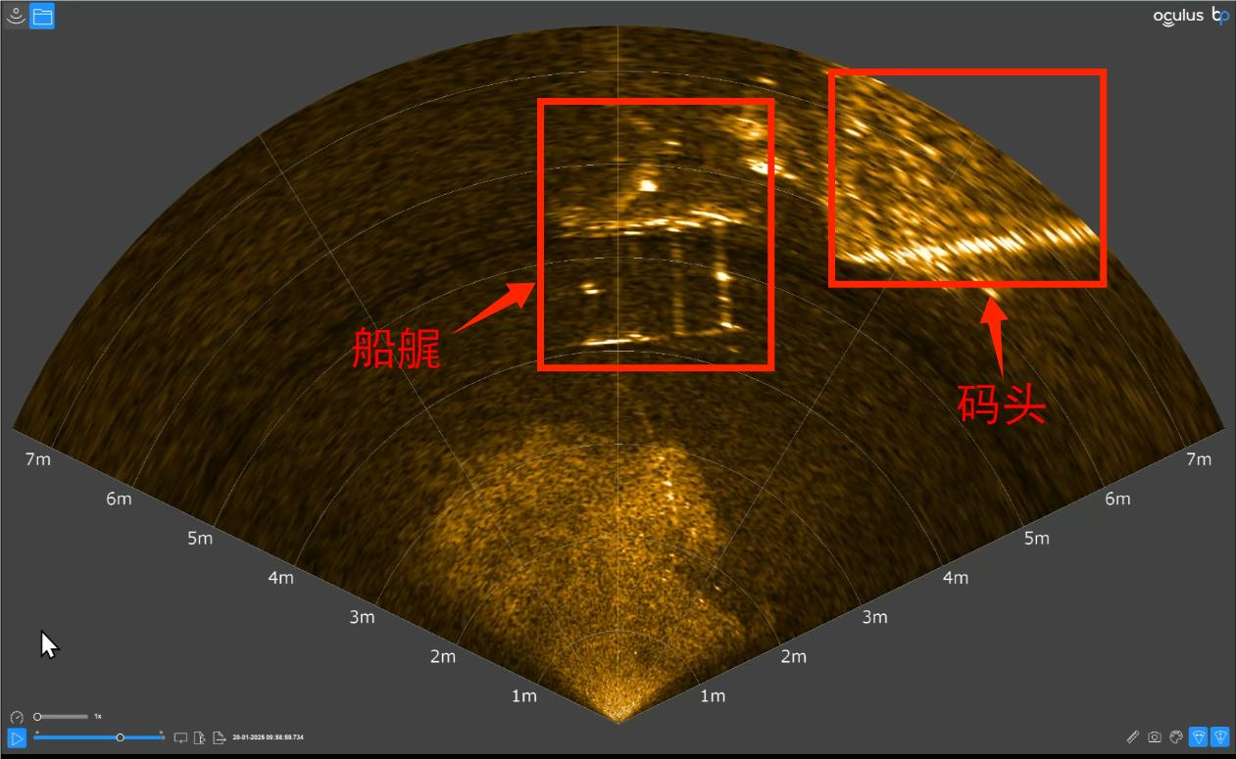
Case Study - Underwater Scanning of Jiantiao Bridge by Sanmen County Police
PART
2.6
Stern of the Ship
Dock
Plastic Water Pipe
ROV Main Unit
On January 20, 2025, the team conducted an on-site underwater scanning demonstration using the Shenlong ROV at the Sinopec fueling dock near Jiantiao Bridge in Sanmen County, Taizhou, simulating the detection of suspicious underwater objects. Relevant leaders from the Sanmen County Public Security Bureau attended the site to provide guidance.

Slide 18
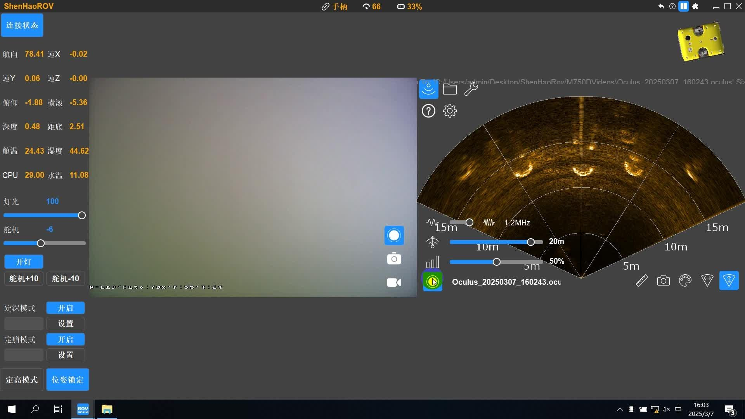
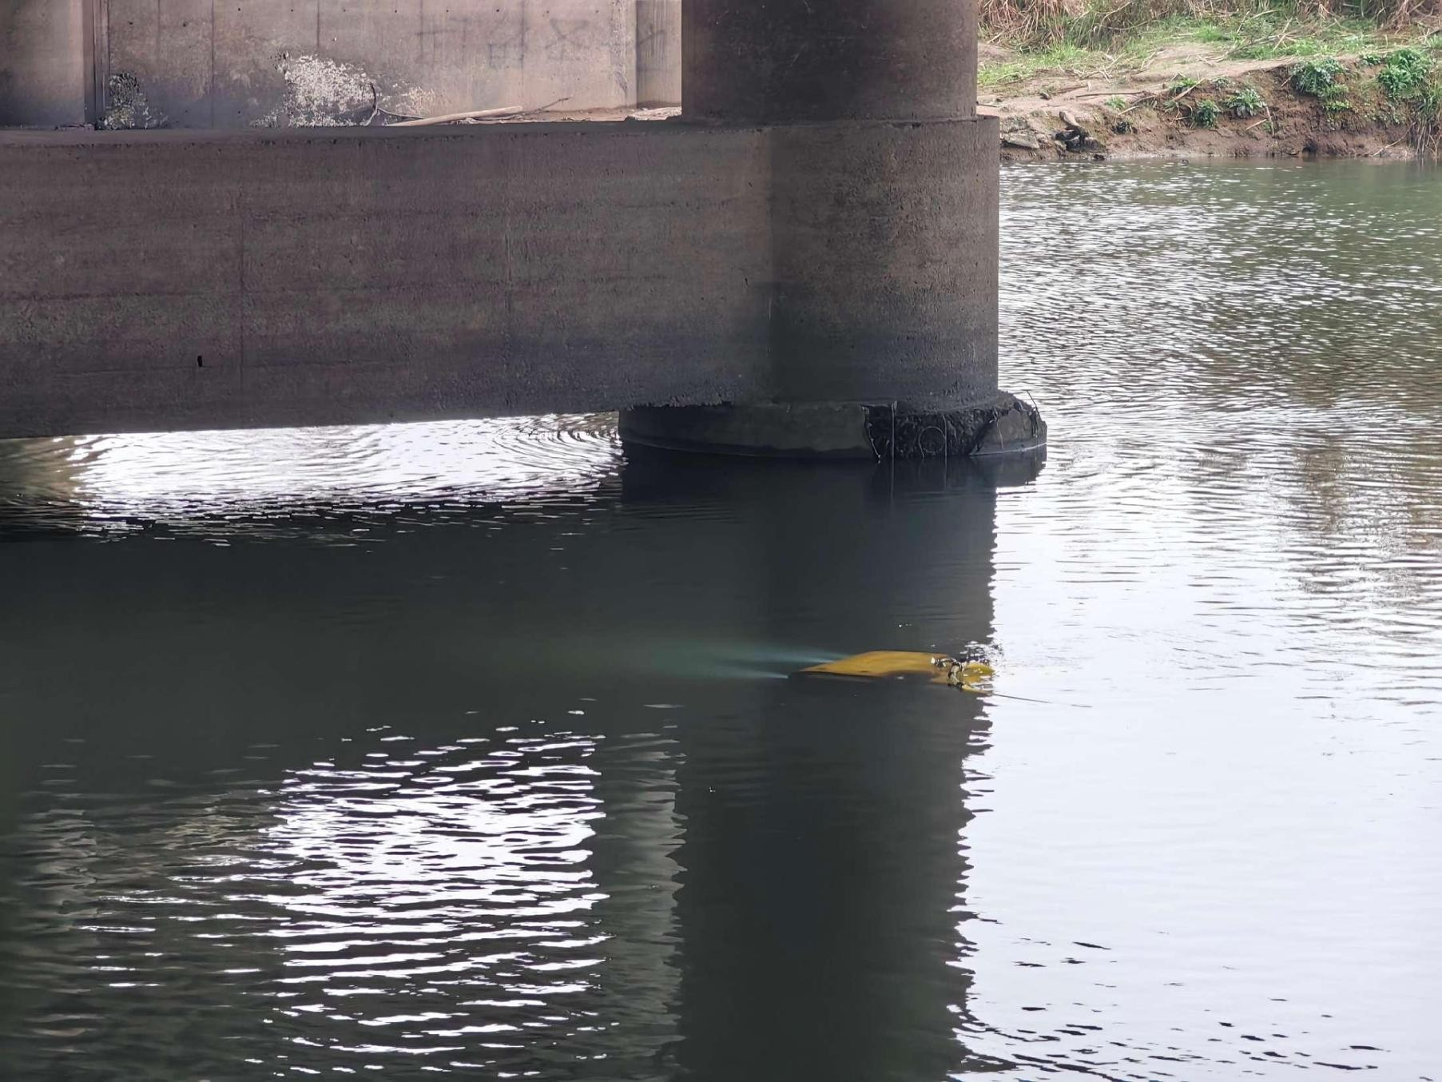
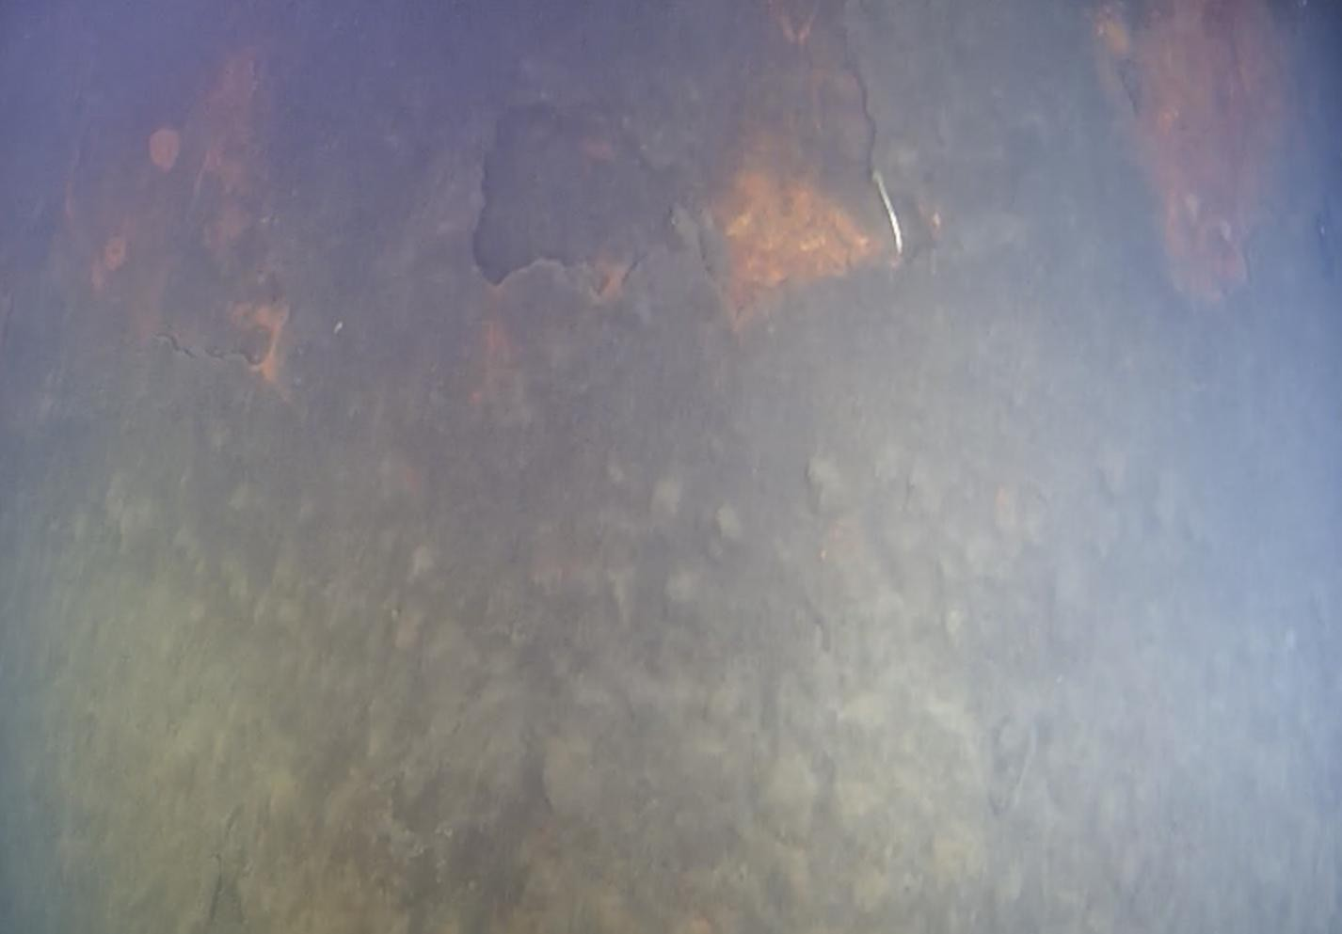
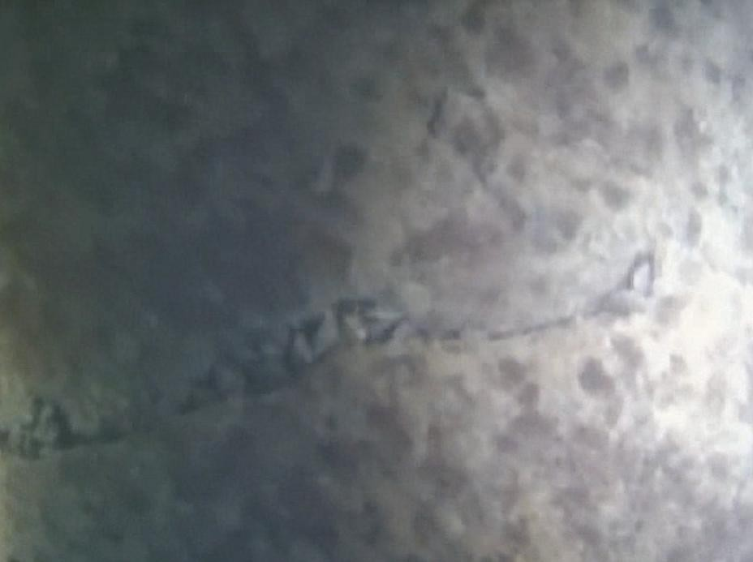
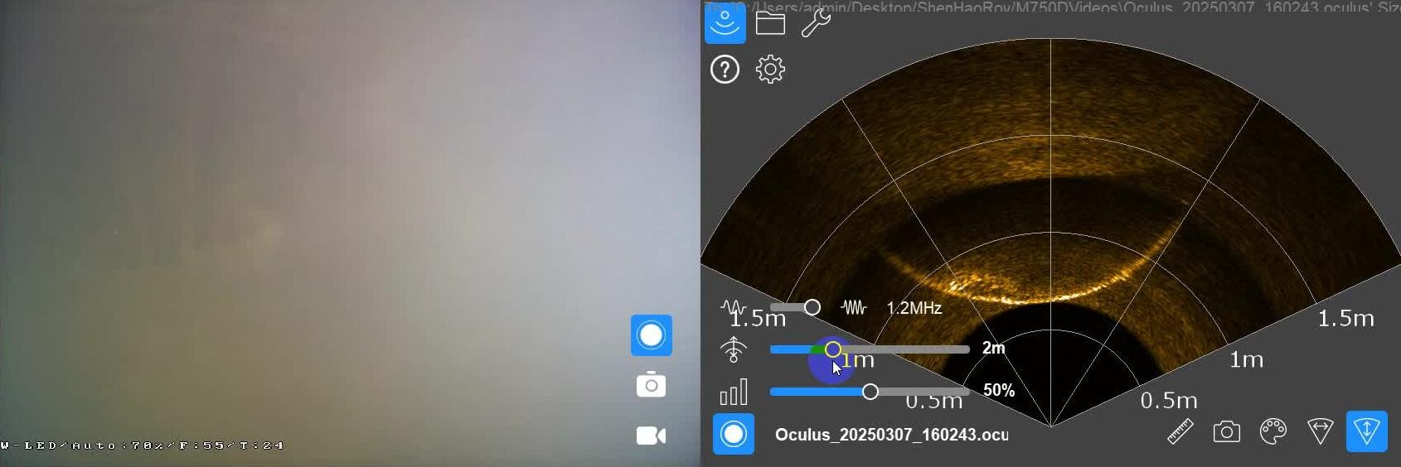
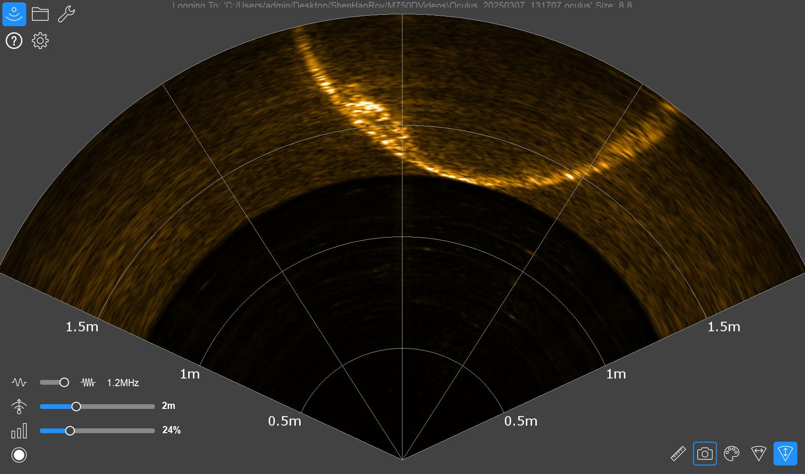

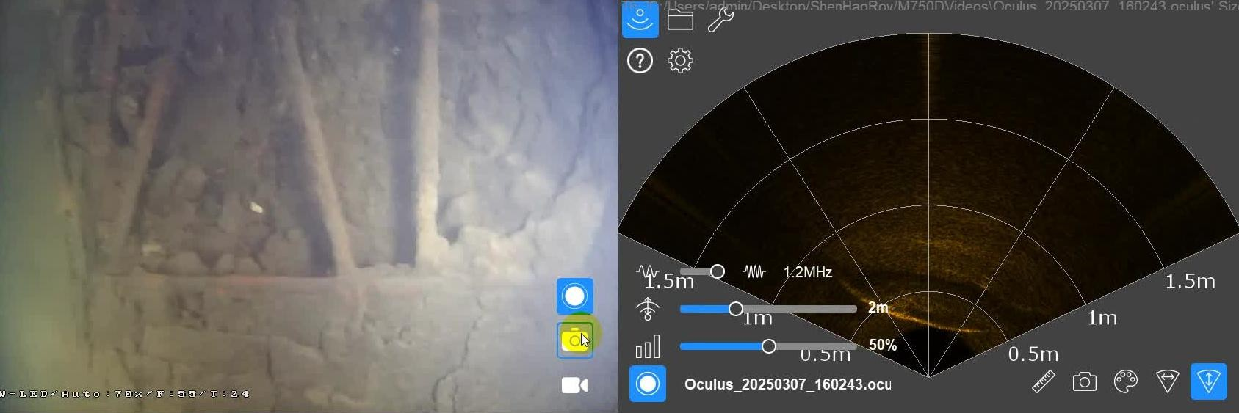
Case Study - Bridge Pier Inspection of the Yuhang Tiaoxi Bridge
PART
2.7
12m
Crack Defects
Corrosion and Spalling Defects
Underwater Inspection
0.7m
0.7m Camera Visibility Limited
Sonar Imaging Clearly Shows Defects
0.3m
The depth and dimensions of defects can be estimated through sonar detection data
On March 7, 2025, the team conducted an on-site trial of the Shenlong ROV for pier foundation inspection at the Tiaoxi Bridge in Yuhang District. Despite some water flow interference in Tiaoxi, the ROV effectively detected damage to the bridge pier foundation using reliable automatic motion control and pose-locking anti-current algorithms and assessed the size of the defects.
Large-scale Spalling, Exposed Rebar

Slide 19
Industrial Health has Shenhao Troubleshooting is No Longer Difficult
Stock Code：300853

